Slide 1
Introduction to Artificial Intelligence
(Symbolic AI)
Siphokazi Tswane

Slide 2
Subject Guide
Term Dates
Assessments
Term 1 – Individual Assignment (20%)
Term 2 - Individual Assignment (10%) , Test (20%)
Term 3 – Group Project (10%), Test (10%)
Term 4 – Final Test 30%

Slide 3
3
Assignment 1 Weight: 20% Due Date: 23:59, 12 April 2021
This is an individual assignment.
Conduct research and provide a brief report on the modern day Applications of Artificial Intelligence.
Consult available resources on the internet. This should include journal articles, conference papers, white papers, blogs etc. Do not use Wikipedia All referenced sources of information must be duly cited. Please include the signed plagiarism declaration. The university takes plagiarism seriously. No plagiarised work will be marked. Include a signed plagiarism with your submission. For more information read https://www.plagiarism.org/. The text similarity index between your write-up and the content of your sources should not exceed 20%.
An abstract is expected from each student
Your report must be written in Microsoft Word using Times New Roman, font size 12, 1.5 spacing. Your report including an Abstract should not exceed 7 (A4) pages.
The report needs to be submitted on Blackboard under Assignment 1. Use Harvard Referencing to indicate your sources.

Slide 4
4
Marking Rubrics
Marking Rubric
Appearance Front page, back page, headings, page numbers etc. | 10%
Introduction and Conclusion What does this report do? | 10%
Research & Referencing | 10%
Body | 70%
Total Mark | 100 marks

Slide 5
Introduction to Artificial Intelligence
Lecture 1

Slide 6
Introduction to AI
AI Definition
Related Fields
History of AI
AI Philosophy
Applications of AI (Planning, understanding, natural language processing, parallel and distributed AI, learning, connectionist model, robotics, expert systems, fuzzy logic, artificial neural networks)

Slide 7
History of AI
1943: early beginnings
McCulloch & Pitts: Boolean circuit model of brain
1950: Turing
Turing's "Computing Machinery and Intelligence“
1951: Initial promise of AI
Early AI programs, including
Samuel's checkers program
Newell & Simon's Logic Theorist
1956: birth of AI
Dartmouth meeting: "Artificial Intelligence“ the name adopted
Notes:
1943 – 1955 Warren McCulloch and Walter Pitts
The first work that is now generally recognized as AI was done by Warren McCulloch and Walter Pitts (1943).
They drew on three sources: 1. knowledge of the basic physiology and function of neurons in the brain;
2. a formal analysis of propositional logic due to Russell and Whitehead; and
3. Turing’s theory of computation.
They proposed a model of artificial neurons in which each neuron is characterized as being “on” or “off,” with a switch to “on” occurring in response to stimulation by a sufficient number of neighboring neurons.
The state of a neuron was conceived of as “factually equivalent to a proposition which proposed its adequate stimulus.” They showed, for example, that any computable function could be computed by some network of connected neurons, and that all the logical connectives (and, or, not, etc.) could be implemented by simple net structures. McCulloch and Pitts also suggested that suitably defined networks could learn. Donald Hebb (1949) demonstrated a simple updating rule for modifying the connection strengths between neurons. His rule, now called Hebbian
HEBBIAN LEARNING learning, remains an influential model to this day.
Turing's test
In 1950 Alan Turing published a landmark paper in which he speculated about the possibility of creating machines that think.^{[29]} Alan Mathison Turing OBE FRS (/ˈtjʊərɪŋ/; 23 June 1912 – 7 June 1954) was an English^{[6]} mathematician, computer scientist, logician, cryptanalyst, philosopher, and theoretical biologist.^{[7]} Turing was highly influential in the development of theoretical computer science, providing a formalisation of the concepts of algorithm and computation with the Turing machine, which can be considered a model of a general-purpose computer.^{[8][9][10]} Turing is widely considered to be the father of theoretical computer science and artificial intelligence.^{[11]} Despite these accomplishments, he was not fully recognised in his home country during his lifetime, due to his homosexuality, and because much of his work was covered by the Official Secrets Act.
He noted that "thinking" is difficult to define and devised his famous Turing Test. If a machine could carry on a conversation (over a teleprinter) that was indistinguishable from a conversation with a human being, then it was reasonable to say that the machine was "thinking". This simplified version of the problem allowed Turing to argue convincingly that a "thinking machine" was at least plausible and the paper answered all the most common objections to the proposition.^{[30]} The Turing Test was the first serious proposal in the philosophy of artificial intelligence.
Game AI[edit]
In 1951, using the Ferranti Mark 1 machine of the University of Manchester, Christopher Strachey wrote a checkers program and Dietrich Prinz wrote one for chess.^{[31]} Arthur Samuel's checkers program, developed in the middle 50s and early 60s, eventually achieved sufficient skill to challenge a respectable amateur.^{[32]} Game AI would continue to be used as a measure of progress in AI throughout its history.
Symbolic reasoning and the Logic Theorist[edit]
When access to digital computers became possible in the middle fifties, a few scientists instinctively recognized that a machine that could manipulate numbers could also manipulate symbols and that the manipulation of symbols could well be the essence of human thought. This was a new approach to creating thinking machines.^{[33]}
In 1955, Allen Newell and (future Nobel Laureate) Herbert A. Simon created the "Logic Theorist" (with help from J. C. Shaw). The program would eventually prove 38 of the first 52 theorems in Russell and Whitehead's Principia Mathematica, and find new and more elegant proofs for some.^{[34]} Simon said that they had "solved the venerable mind/body problem, explaining how a system composed of matter can have the properties of mind."^{[35]} (This was an early statement of the philosophical position John Searle would later call "Strong AI": that machines can contain minds just as human bodies do.)^{[36]}
Dartmouth Conference 1956: the birth of AI[edit]
The Dartmouth Conference of 1956^{[37]} was organized by Marvin Minsky, John McCarthy and two senior scientists: Claude Shannon and Nathan Rochester of IBM. The proposal for the conference included this assertion: "every aspect of learning or any other feature of intelligence can be so precisely described that a machine can be made to simulate it".

Slide 8
History of AI – Cont’d
1966—73: Reality dawns
Realization that many AI problems are intractable
Limitations of existing neural network methods identified
Neural network research almost disappears
1969—85: Adding domain knowledge
Development of knowledge-based systems
Success of rule-based expert systems,
E.g., DENDRAL, MYCIN
But were brittle and did not scale well in practice
Notes:
From the beginning, AI researchers were not shy about making predictions of their coming successes. The following statement by Herbert Simon in 1957 is often quoted:
“It is not my aim to surprise or shock you—but the simplest way I can summarize is to say
that there are now in the world machines that think, that learn and that create. Moreover, their ability to do these things is going to increase rapidly until—in a visible future—the
range of problems they can andle will be coextensive with the range to which the human
mind has been applied.”
AI problems are intractable i.e. hard to control or deal with.
1969—85: Adding domain knowledge
The picture of problem solving that had arisen during the first decade of AI research was of a general-purpose search mechanism trying to string together elementary reasoning steps to
find complete solutions. WEAK METHOD Such approaches have been called weak methods because, although general, they do not scale up to large or difficult problem instances. The alternative to weak methods is to use more powerful, domain-specific knowledge that allows larger reasoning steps and can more easily handle typically occurring cases in narrow areas of expertise. One
might say that to solve a hard problem, you have to almost know the answer already.
The DENDRAL program was an early example of this approach. It was developed at Stanford, where Ed Feigenbaum (a former student of Herbert Simon),
Bruce Buchanan (a philosopher turned computer scientist), and Joshua Lederberg (a Nobel laureate geneticist) teamed up to solve the problem of inferring molecular structure from the
information provided by a mass spectrometer.
AI becomes an industry (1980–present)
The first successful commercial expert system, R1, began operation at the Digital Equipment
Corporation (McDermott, 1982). The program helped configure orders for new computer
systems; by 1986, it was saving the company an estimated $40 million a year. By 1988,
DEC’s AI group had 40 expert systems deployed, with more on the way. DuPont had 100 in
use and 500 in development, saving an estimated $10 million a year. Nearly every major U.S.
corporation had its own AI group and was either using or investigating expert systems.
In 1981, the Japanese announced the “Fifth Generation” project, a 10-year plan to build
intelligent computers running Prolog.

Slide 9
History of AI – Cont’d
1986-- Rise of machine learning
Neural networks return to popularity
Major advances in machine learning algorithms and applications
1990-- Role of uncertainty
Bayesian networks as a knowledge representation framework
Notes:
1986-- Rise of machine learning
In the mid-1980s at least four different groups reinvented the back-propagation learning algorithm(a process or set of rules to be followed in calculations or other problem-solving operations, especially by a computer.) first found in 1969 by Bryson and Ho. The algorithm was applied to many learning problems in computer science and psychology, and the widespread dissemination of the results in the collection Parallel Distributed Processing (Rumelhart and McClelland, 1986)
caused great excitement. CONNECTIONIST These so-called connectionist models of intelligent systems were seen by some as direct
competitors both to the symbolic models promoted by Newell and Simon and to the
logicist approach of McCarthy and others (Smolensky, 1988).
Judea Pearl’s (1988) Probabilistic Reasoning in Intelligent Systems led to a new acceptance of probability and decision theory in AI, following a resurgence of interest epitomized
BAYESIAN NETWORK by Peter Cheeseman’s (1985) article “
In Defense of Probability.” The Bayesian network formalism was invented to allow efficient representation of, and rigorous reasoning with, uncertain knowledge. This approach largely overcomes many problems of the probabilistic
reasoning systems of the 1960s and 1970s; it now dominates AI research on uncertain reasoning and expert systems. The approach allows for learning from experience, and it combines
the best of classical AI and neural nets.
Bayesian networks are a type of probabilistic graphical model that uses Bayesian inference for probability computations. Bayesian networks aim to model conditional dependence, and therefore causation, by representing conditional dependence by edges in a directed graph.
The emergence of intelligent agents (1995–present)
Perhaps encouraged by the progress in solving the subproblems of AI, researchers have also
started to look at the “whole agent” problem again.

Slide 10
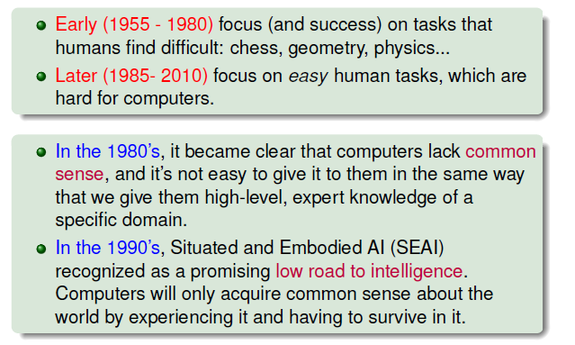
Slide credit: Lester Solbakken, Introduction to AI, NTNU

Slide 11
Some task Domain in A.I.
Mundane Tasks
perception (vision, speech)
Natural Language processing (understanding, generation, translation)
Commonsense reasoning
Robot control
Formal tasks
Games (Checkers, Chess, Ayo etc.)
Mathematics (Geometry, Logic, Calculus, Proving properties of Program)
Expert Tasks
Engineering (Design, fault finding, manufacturing planning)
Scientific analysis
Medical analysis
Financial analysis

Slide 12
Developments in AI
1. Problem Solving and Planning: This deals with systematic refinement of goal hierarchy, plan revision mechanisms and a focused search of important goals.
2. Expert Systems: This deals with knowledge processing and complex decision-making problems.
3. Natural Language Processing: Areas such as automatic text generation, text processing, machine translation, speech synthesis and analysis, grammar and style analysis of text etc. come under this category.
Notes:
Artificial Intelligence (continued)
Learning systems
Allow computers to learn from past mistakes or experiences
Neural networks
Allow computers to recognize and act on patterns or trends

Slide 13
Developments in AI – Cont’d
4. Robotics: This deals with the controlling of robots to manipulate or grasp objects and using information from sensors to guide actions etc.
5. Computer Vision: This topic deals with intelligent visualization, scene analysis, image understanding and processing and motion derivation.
6. Learning: This topic deals with research and development in different forms of machine learning.

Slide 14
Developments in AI – Cont’d
7.Genetic Algorithms: These are adaptive algorithms which have inherent learning capability. They are used in search, machine learning and optimization.
8. Neural Networks: This topic deals with simulation of learning in the human brain by combining pattern recognition tasks, deductive reasoning and numerical computations.
Application Areas of AI
Autonomous Planning and Scheduling, Game Playing, Autonomous Control, Diagnosis, Logistics Planning, Robotics, Language Understanding and Problem Solving
Notes:
Artificial Intelligence (continued)
Learning systems
Allow computers to learn from past mistakes or experiences
Neural networks
Allow computers to recognize and act on patterns or trends

Slide 15
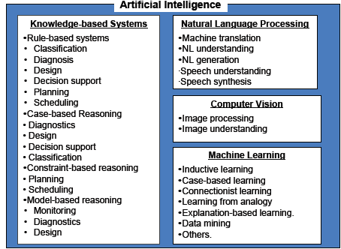

Slide 16
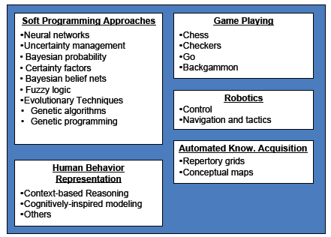

Slide 17
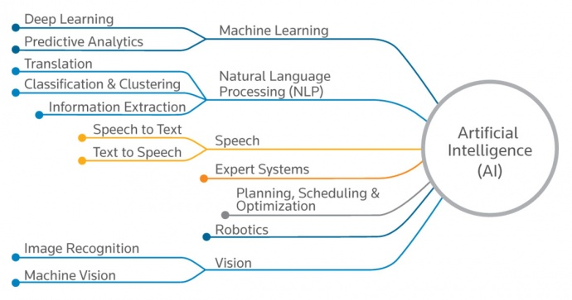

Slide 18
Some Pertinent Questions in A.I.
What are our underlying assumptions about intelligence?
What kinds of technique will be useful for solving AI problems?
At what level of detail, if at all, are we trying to model human intelligence?
How will we know when we have succeeded in building an intelligent program?
Notes:
a. What are our underlying assumptions about intelligence?
there are infinite underlying assumptions of Artificial Intelligence, where research is going on those assumptions.
Automation in every aspect of human life.
Deploying AI in every field of science , so that machines save our time and labor.
Deploying AI machines in every company to do work faster and thus saving the capital , investment and making huge profits.
Many more infinite Underlying assumptions are there.
Artificial Intelligence has aroused the feeling of innovation and unique strategies in millions of people. Everyone is talking about AI and it’s applications, people are not that much aware about the threats that we are facing along all with the benefits.
Few Artificial Intelligence(AI) assumptions are:
The same AI strategy will not fit for every use case.
Artificial Intelligence and Machine Learning are not interchangeable.
In AI, Algorithms are not important than data.
AI lacks an important human trait i.e. Empathy.
AI results in cultural and skills shift.
Artificial intelligence has ignited our imaginations over the future of work since John McCarthy first coined the term in 1955. While Hollywood often depicts AI as an ominous tool – take War Games and Terminator, and even HAL in 2001: Space Odyssey – in reality, AI has become a real and growing part of our lives, and not just in video games. Within organizations, there are real-life AI applications being deployed that automate business processes to improve customer experience. But we are also hearing progressively more myths when it comes to business applications. The following are common myths, assumptions, and truths to know as you consider your AI strategy in 2018.
1. An AI strategy is not one size fits all
I can’t tell you how many times I’ve met a CIO or CTO who wanted to know what our AI strategy was. I usually try to qualify their interest with a question of my own, “What does AI mean to you?”
That question is typically followed by dead silence. The issue is that CTOs expect the same AI strategy to fit every use case. The real question that should be asked is, “What are customers actually trying to do?”
Usually, the use cases come down to basic machine learning. Customers want a system to watch and learn what their knowledge workers are doing as part of their daily routines – especially routines they are considering automating with robotic process automation (RPA). They want a system that can then start recommending various courses of action based on learned behavior. Finally, they want the knowledge worker to be able to direct the system to automate the learned behavior after getting comfortable with past recommendations.
2. AI and machine learning are not interchangeable
Machine learning is often misinterpreted for AI, as are cognitive processing, natural language processing, and deep learning. Machine learning is an application of AI whereas it gives machines access to data and lets them learn for themselves, thus enabling AI.
It’s the combination of RPA and machine learning that organizations interpret as AI. Once organizations have automated various tasks by adding a level of learned intelligence, they’ll be able to monitor and understand the impact those efforts are having on their organization via real-time process discovery and process intelligence.
3. Algorithms are not more important than data
This is akin to the chicken-or-the-egg conundrum. Algorithms need data to work, yet algorithms enable you to do whatever you want with data. However, the design of an algorithm is guided by the data structure they are supposed to work with, so in reality, data is more important than the algorithm.
4. AI lacks an important human trait: Empathy
In reality, AI replaces mundane, repetitive and error-prone tasks so humans can focus on value-added processes that require creativity, problem solving and flexibility. However, workers carry unique characteristics like empathy and judgment that robots lack. Although, when this comes to having quick support or customer experience, chatbots have taken the game ahead pretty well and quick. You can find interesting content to read by clicking here.
5. Expect a cultural and skills shift
Organizations can count on seeing a dramatic change within the company culture and employee skillset within the next three to five years. However, embracing AI needs to lead from the CEO and spread throughout the workforce in order to be successful due to the human nature’s reluctance to accept change. Having management spearhead the cultural shift will foster acceptance quicker.
From a skills perspective, the introduction of AI into the general workplace will result in more tasks being addressed by the system of record applications. For example, in the mortgage lending market, the dependency on a loan origination officer to drive the loan process will lessen due to the loan origination system being able to make intelligent decisions based on past funding behavior. This will leave only rules-based exceptions to require a loan processor’s attention. As a result, this will lighten the overall workload for loan officers, allowing them to be more responsive when an exception rises and should allow mortgage lenders to increase the productivity of their operations.
b. What kinds of technique will be useful for solving AI problems?
The reflex agents are known as the simplest agents because they directly map states into actions. Unfortunately, these agents fail to operate in an environment where the mapping is too large to store and learn. Goal-based agent, on the other hand, considers future actions and the desired outcomes.
Here, we will discuss one type of goal-based agent known as a problem-solving agent, which uses atomic representation with no internal states visible to the problem-solving algorithms.
What steps are involved in developing a problem solving agent?
Before an agent can start searching for solutions, it must formulate a goal and then use that goal to formulate a problem. A problem consists of five parts: The state space, an initial situation, actions, a goal test, and path costs. A path from an initial state to a goal state is a solution.

Slide 19
The Physical Symbol System Hypothesis
The Physical Symbol System is a machine that produces a series of symbols and structures over time
A PSS has the necessary and sufficient means for general intelligent action
Results of PSS Research
Lots of impressive AI systems with more to come
Erroneous view of the human mind as a PSS running on a computer-like hardware
PSS Hypothesis is still important for development of AI systems but less important for AI-inspired cognitive science
Notes:
A physical symbol system (also called a formal system) takes physical patterns (symbols), combining them into structures (expressions) and manipulating them (using processes) to produce new expressions.
Hypothesis - a supposition or proposed explanation made on the basis of limited evidence as a starting point for further investigation.
The physical symbol system hypothesis (PSSH), first formulated by Newell and Simon in their Turing Award paper,1 states that “a physical symbol system [such as a digital computer, for example] has the necessary and sufficient means for intelligent action.” The hypothesis implies that computers, when we provide them with the appropriate symbol-processing programs, will be capable of intelligent action. It also implies, as Newell and Simon wrote, that “the symbolic behavior of man arises because he has the characteristics of a physical symbol system.” Newell and Simon admitted that
“The hypothesis could indeed be false. Intelligent behavior is not so easy to produce that any system will exhibit it willy-nilly. Indeed, there are people whose analyses lead them to conclude either on philosophical or on scientific grounds that the hypothesis is false. Scientifically, one can attack or defend it only by bringing forth empirical evidence about the natural world.”
The physical symbol system hypothesis (PSSH) is a position in the philosophy of artificial intelligence formulated by Allen Newell and Herbert A. Simon. They wrote:
"A physical symbol system has the necessary and sufficient means for general intelligent action."^{[1]}
— Allen Newell and Herbert A. Simon
This claim implies both that human thinking is a kind of symbol manipulation (because a symbol system is necessary for intelligence) and that machines can be intelligent (because a symbol system is sufficient for intelligence).^{[2]}
The idea has philosophical roots in Hobbes (who claimed reasoning was "nothing more than reckoning"), Leibniz (who attempted to create a logical calculus of all human ideas), Hume (who thought perception could be reduced to "atomic impressions") and even Kant (who analyzed all experience as controlled by formal rules).^{[3]} The latest version is called the computational theory of mind, associated with philosophers Hilary Putnam and Jerry Fodor.^{[4]}
The hypothesis has been criticized strongly by various parties, but is a core part of AI research. A common critical view is that the hypothesis seems appropriate for higher-level intelligence such as playing chess, but less appropriate for commonplace intelligence such as vision. A distinction is usually made between the kind of high level symbols that directly correspond with objects in the world, such as <dog> and <tail> and the more complex "symbols" that are present in a machine like a neural network.
AI-inspired cognitive science - scientific study of the human reasoning, emotions, language, perception, attention, and memory.

Slide 20
Underlying Assumption
A Physical symbol system (PSS) consist of:
Symbols which are physical patterns which occur as components of another entity called expression or symbol structure.
It contains a collection of processes that operate on expressions to produce other expressions. This includes processes of creation, modification, reproduction and destruction.
A PSS is a machine that produces through time an existing set of symbol structures.
Using the computer as a medium for this experimentation has been found to be true
Notes:
A physical symbol system (also called a formal system) takes physical patterns (symbols), combining them into structures (expressions) and manipulating them (using processes) to produce new expressions.

Slide 21
Importance of the PSS Hypothesis
The importance of the physical symbols system hypothesis is two fold:
It is a significant theory of the nature of human intelligence and so is of great interest to psychologists.
It also forms the basis of the belief that it is possible to build programs that can perform intelligent tasks now performed by people.
Notes:
The importance of the physical symbols system hypothesis is two fold:
It is a significant theory of the nature of human intelligence and so is of great interest to psychologists.
It also forms the basis of the belief that it is possible to build programs that can perform intelligent tasks now performed by people.

Slide 22
Good Old Fashioned Artificial Intelligence (GOFAI)
In GOFAI, Knowledge is represented using symbols
Reasoning is done by using symbolic knowledge.
For example, a variety of different formal logics have been used in GOFAI.
Logic is a formal way of representing the state of the world and reasoning about it.
Logic programming systems, such as Prolog, compute the consequences of the axioms and rules in order to answer a query.
Notes:
Symbolic artificial intelligence is the term for the collection of all methods in artificial intelligence research that are based on high-level "symbolic" (human-readable) representations of problems, logic and search. Symbolic AI was the dominant paradigm of AI research from the mid-1950s until the late 1980s
John Haugeland gave the name GOFAI ("Good Old-Fashioned Artificial Intelligence") to symbolic AI in his 1985 book Artificial Intelligence: The Very Idea, which explored the philosophical implications of artificial intelligence research. In robotics the analogous term is GOFR ("Good Old-Fashioned Robotics").
The approach is based on the assumption that many aspects of intelligence can be achieved by the manipulation of symbols, an assumption defined as the "physical symbol systems hypothesis" by Allen Newell and Herbert A. Simon in the middle 1960s.
One popular form of symbolic AI is expert systems, which uses a network of production rules. Production rules connect symbols in a relationship similar to an If-Then statement. The expert system processes the rules to make deductions and to determine what additional information it needs, i.e. what questions to ask, using human-readable symbols.
Opponents of the symbolic approach include roboticists such as Rodney Brooks, who aims to produce autonomous robots without symbolic representation (or with only minimal representation) and computational intelligence researchers, who apply techniques such as neural networks and optimization to solve problems in machine learning and control engineering.
Symbolic AI was intended to produce general, human-like intelligence in a machine, whereas most modern research is directed at specific sub-problems. Research into general intelligence is now studied in the sub-field of artificial general intelligence.
GOFAI
==
GOFAI is also known as "symbolicism," for its attempt to describe intelligence in symbolic terms. Its basis is what has been termed the "symbol system hypothesis," which states that it is possible to construct a universal symbol system that is intelligent. Since a computer is nothing more than a universal symbol system, this is the claim that computers are the right kind of machines to think.
To explain: for all computers can do, they are in essence just manipulators of symbols, where the symbols are collections of 1's and 0's and are organized in words and lines and pages. A computer can copy symbols, move them, delete, write a sequence of symbols in a specific place, compare symbols in two different places, and search for symbols that match certain patterns. All the more complicated behavior exhibited by computers is simply the result of combinations these basic manipulations. The revolutionary move made by Turing was the creation of the universal symbol manipulator, on which one can represent any other symbol manipulator. This is how computers can run programs that do anything, and how computers can be made to act like other computers.
The recipe for building an intelligent machine out of a computer is:
Use a sufficiently complex code to represent real-world objects, events, relationships, etc.
Create a "knowledge base," a vastly interconnected system of symbols inside a universal symbol system, e.g. a digital computer.
Use input devices to create symbolic representations of changing stimuli in the machine's proximity.
Have complex sequences of the symbol system's manipulations applied to the symbol structures such that new symbol structures result, which are designated as output.
Interpret the symbolic output into appropriate behavioral responses.
The hypothesis of GOFAI is simply that this is the correct recipe and that therefore this is how one should proceed to create intelligent agents. There is also a "strong symbol system hypothesis" which states that only universal symbol systems are capable of thinking, and this is how the idea of modelling human intelligence is applied to GOFAI: human beings, and in fact all living things which show intelligent behavior, are, at close inspection, computers made out of different materials. Newell and Simon agree with this hypothesis when they claim that "[s]ymbols lie at the root of intelligent action," and the thesis that the brain is primarily a manipulator of symbols has become a popular one among many AI researchers and philosophers. The hypothesis has been argued against vehemently by two camps. Such researchers as John Searle and Karl Lashley have pointed out that scientists have always modelled the brain on the most fashionable technology of the day; Descartes developed a theory comparing the brain to a water clock, and Leibniz claimed that the brain could be likened to a factory. The response to this is typical of AI's future-looking premise: just because the brain has been shown not to be a factory or a telephone switchboard does not mean that the brain is not a computer. This is a perfectly reasonable response, since the symbol hypothesis is an empirical theory, although the lack of definitive empirical evidence after fifty years might make some researchers think twice about it.The other criticism of GOFAI in relation to human intelligence is that there is no evidence in the physiology of the brain that the symbol is the atomic unit of cognition in the same way it is in a computer. Generally such critics argue that connectionism offers a much closer model of human intelligence by using the artificial neuron as its atomic unit.
back

Slide 23
Example of Logic Representation
A South African and CPUT Professor has just receieved a national award
( x)( y)( z)(isSouthAfrican(x) Ʌ isProfessor(x,y) Ʌ Received-National_Award(x,z)).
Notes:
Knowledge representation deals primarily with the representational and reasoning challenges of this separate component.

Slide 24
Problem with Logic
Problems were soon encountered about the lack of common sense in logic-based systems.
Lenat’s Cyc attempted to store common sense, but it is now considered a failure.
GOFAI approaches are mainly logic based and have been found to be deficient in solving many times of real-world problems.
Connectionist approach, which is based on the functioning of the biological human brain is now preferred .

Slide 25
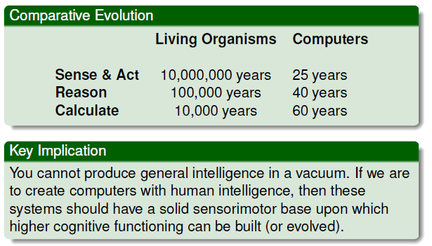
The new AI: Situated and Embodied Artficifial Intelligence (SEAI)
Slide credit: Keith Downing, Evolving Artificial Intelligence, NTNU
Notes:
Situated and embodied artificial intelligence (SEAI) aims to build animats that acquire a common-sense understanding of the world via interactions between simulated brains, bodies and environment.44
An animat is a simulated animal or a robot whose structure and functionalities are as much inspired from current biological knowledge as possible, in the hope that it will exhibit at least some of the survival capacities of real animals. The term "animat" was introduced in Wilson (1985).

Slide 26
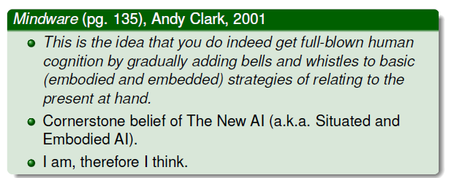
Cognitive Incrementalism
Slide credit: Keith Downing, Evolving Artificial Intelligence, NTNU
Notes:
Incrementalism –belief in or advocacy of change by degrees; gradualism.
Cognitive - relating to, being, or involving conscious intellectual activity (such as thinking, reasoning, or remembering)
Cognition - the mental action or process of acquiring knowledge and understanding through thought, experience, and the senses.

Slide 27
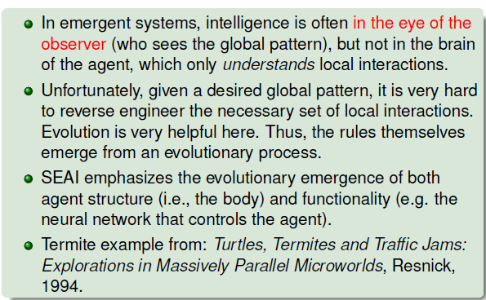
Mistaken Genius
Slide credit: Keith Downing, Important Tools and Perspectives for the Future of AI

Slide 28
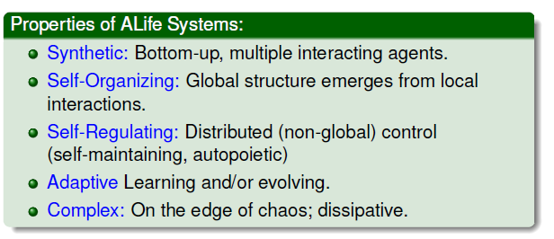
Artificial Life Systems
Slide credit: Keith Downing, Evolving Artificial Intelligence, NTNU
Notes:
Human beings create machines to do things more quickly and more efficiently, but some are beginning to believe that our own inventions may one day become our own children. Are machines capable of being recognized as living beings? One of the earliest experiments at simulating life in technology was a simple mathematical game created by John H. Conway, first published and popularized during the early 1970's in issues of Scientific American. He called it "The Game of Life.
rtificial life (often abbreviated ALife or A-Life) is a field of study wherein researchers examine systems related to natural life, its processes, and its evolution, through the use of simulations with computer models, robotics, and biochemistry.^{[1]} The discipline was named by Christopher Langton, an American theoretical biologist, in 1986.^{[2]} In 1987 Langton organized the first conference on the field, in Los Alamos, New Mexico.^{[3]} There are three main kinds of alife,^{[4]} named for their approaches: soft,^{[5]} from software; hard,^{[6]} from hardware; and wet, from biochemistry. Artificial life researchers study traditional biology by trying to recreate aspects of biological phenomena.^{[7][8]}

Slide 29
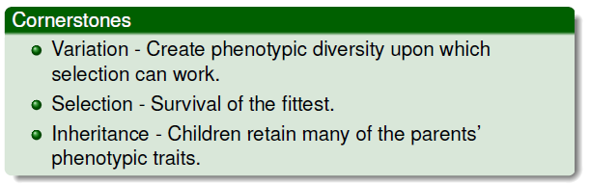
Biologically Inspired AI
: Evolutionary Systems
Slide credit: Keith Downing, Evolving Artificial Intelligence, NTNU
Notes:
A comprehensive introduction to new approaches in artificial intelligence and robotics that are inspired by self-organizing biological processes and structures.
New approaches to artificial intelligence spring from the idea that intelligence emerges as much from cells, bodies, and societies as it does from evolution, development, and learning. Traditionally, artificial intelligence has been concerned with reproducing the abilities of human brains; newer approaches take inspiration from a wider range of biological structures that that are capable of autonomous self-organization

